Slide 1
Supervisor meeting 6
Lasse Leuchtmann

Slide 2
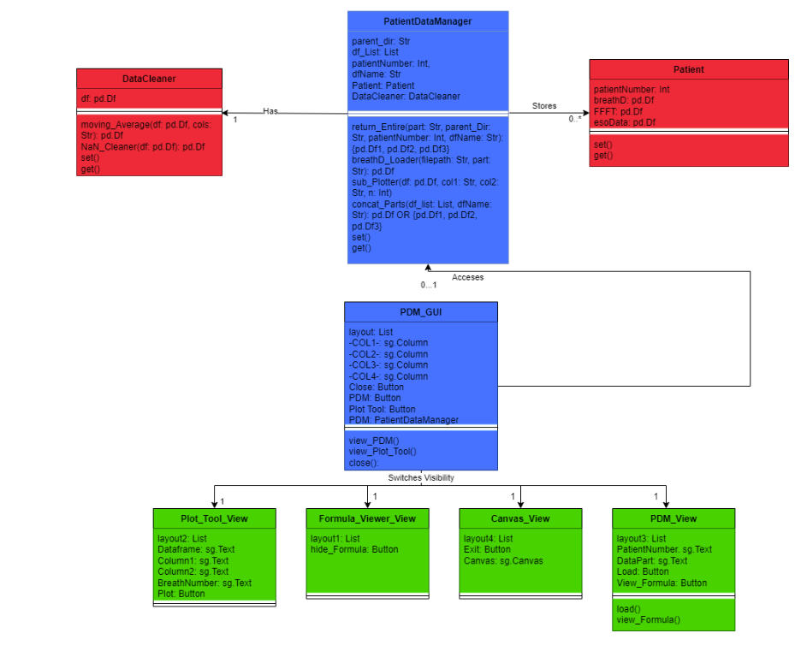
Improved Dashboard Capabilities

Slide 3

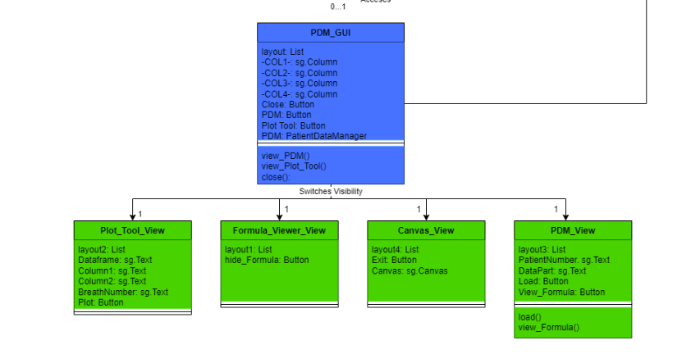

Improved Dashboard Capabilities

Slide 4

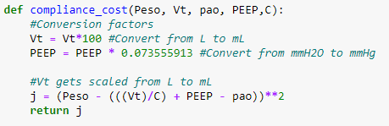
Built Cost Function

Slide 5
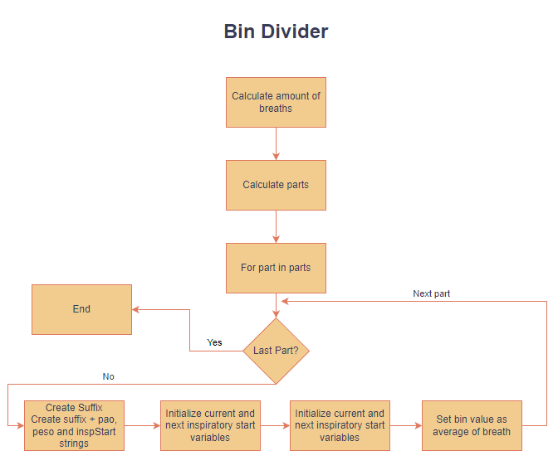
Divide Data Into Bins

Slide 6
Filtering
Dynamic Moving Medium Filter
Unsquare Moving Average

Slide 7
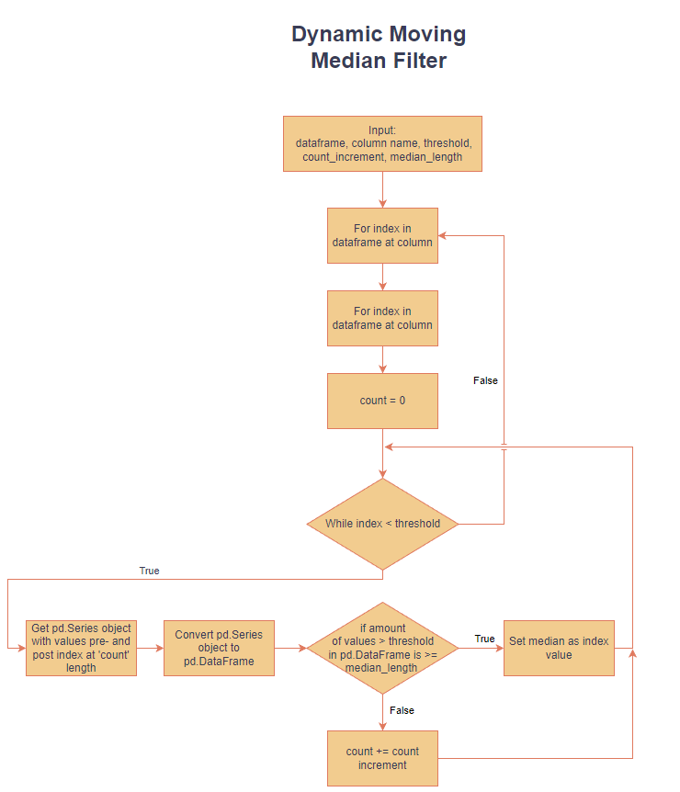
Filtering

Slide 8
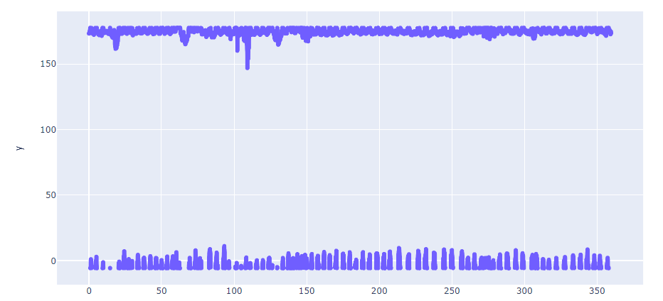
Filtering - Pre

Slide 9
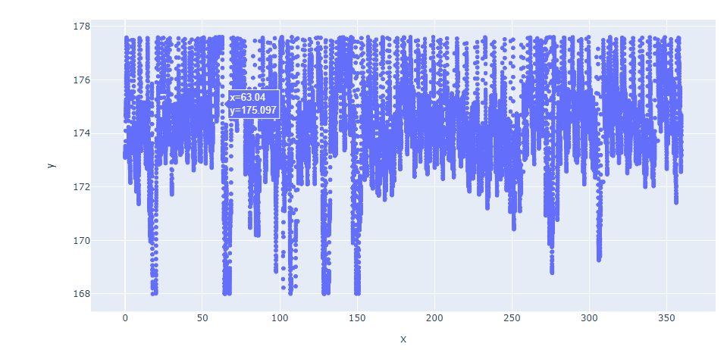
Filtering - Median

Slide 10
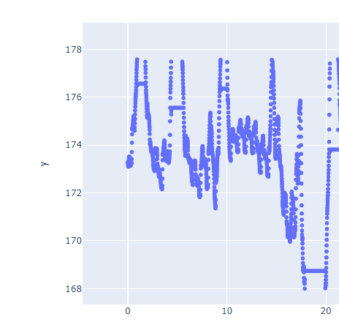
Filtering - Median

Slide 11
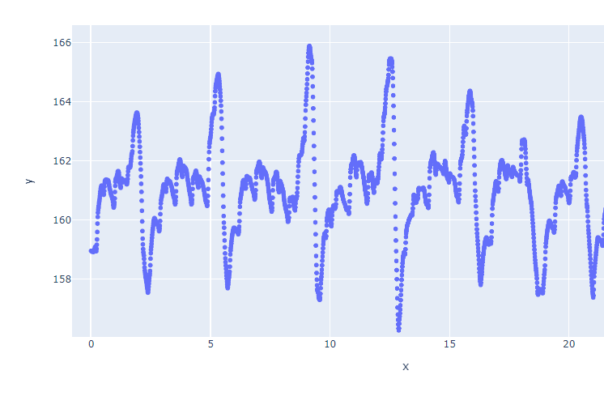
Filtering – Moving Average

Slide 12
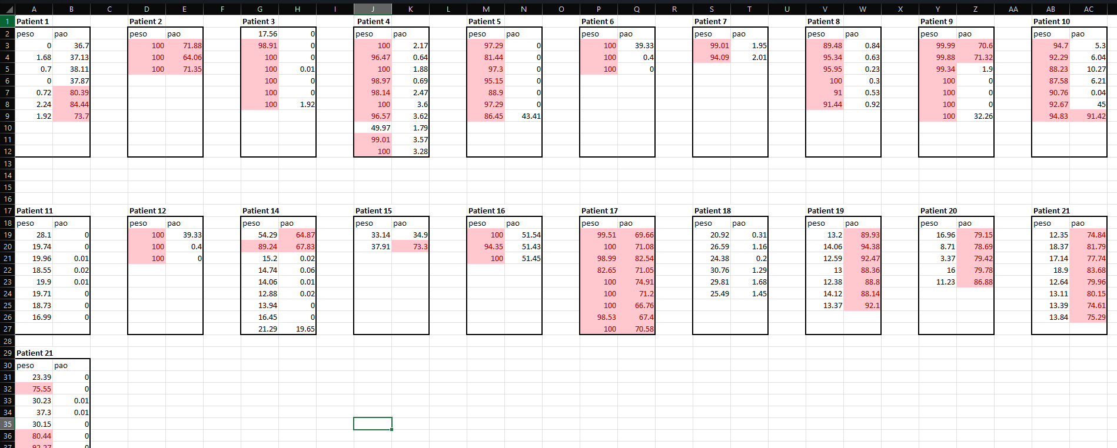
Problems with data quality

Slide 13
Grid Search Live Demo

Slide 14
Q/A
Prepared questions
Unit Conversion: How do I ensure that the values used in calculating the loss are aligned with each other?
Filtering: Do you have any proposals for better filtering techniques?
Data Quality: How do I deal with the amount of corrupted data, if I don’t want to let it go to waste?
Etc.

